Slide 1
Corruption and Stock Markets
By Jacob Snyder

Slide 2
Intro
Stock markets as a proxy for economy/development progress
Stocks markets have concrete data sets
Theory: Control of Corruption ~ Size/stability of economy/stock market

Slide 3
Literature
“[…] corruption greases the wheels of economy by expediting transactions and allowing private firms to overcome governmentally imposed inefficiencies” (Mouselli 2016)
“ an increase in corruption level, […] adverse effect on the development of the stock markets due to the spread of abuse in the markets” (Arslan 2013)

Slide 4
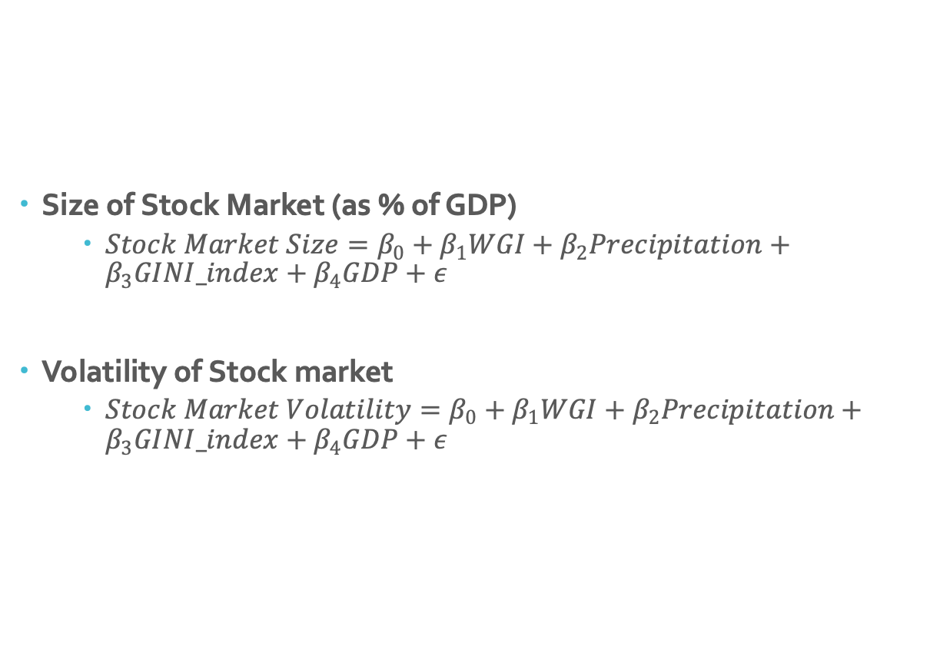
Model
Size of Stock Market (as % of GDP)
$Stock Market Size=β_{0}+β_{1}WGI+β_{2}Precipitation+β_{3}GINI_index+β_{4}GDP+ε$
Volatility of Stock market
$Stock Market Volatility=β_{0}+β_{1}WGI+β_{2}Precipitation+β_{3}GINI_index+β_{4}GDP+ε$

Slide 5
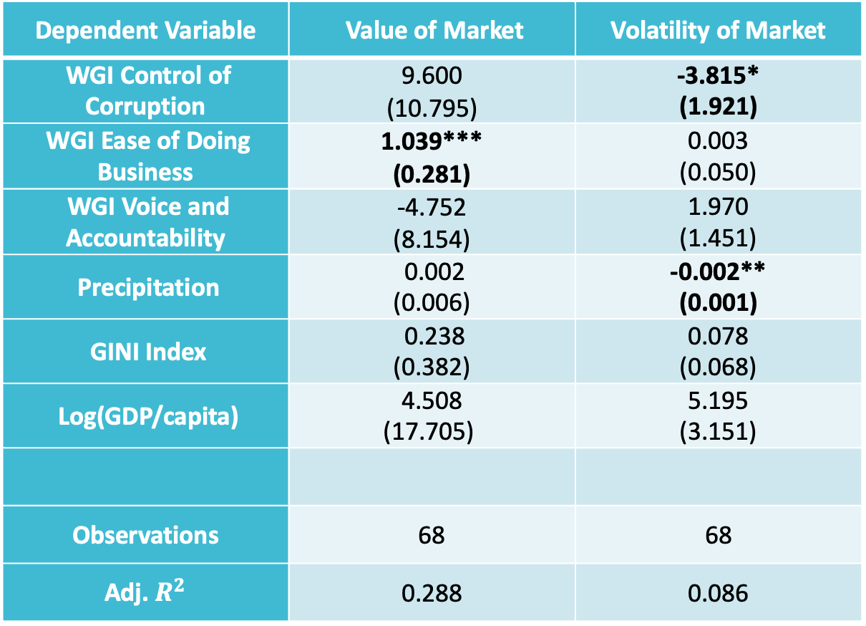
Regressions
Dependent Variable | Value of Market | Volatility of Market
WGI Control of Corruption | 9.600 (10.795) | -3.815* (1.921)
WGI Ease of Doing Business | 1.039*** (0.281) | 0.003 (0.050)
WGI Voice and Accountability | -4.752 (8.154) | 1.970 (1.451)
Precipitation | 0.002 (0.006) | -0.002** (0.001)
GINI Index | 0.238 (0.382) | 0.078 (0.068)
Log(GDP/capita) | 4.508 (17.705) | 5.195 (3.151)
Observations | 68 | 68
Adj. $R^{2}$ | 0.288 | 0.086
Sources: WGI Control of Corruption, WGI Ease of Doing Business, WGI Voice and Accountability from the WGI website. Log(GDP/capita) from World Bank data. Precipitation from Food and Agriculture Organization. GINI Index from the Poverty and Inequality platform of the World Bank.
Robust standard error in parentheses. * Significant at 10%; ** Significant at 5%; *** Significant at 1%.

Slide 6
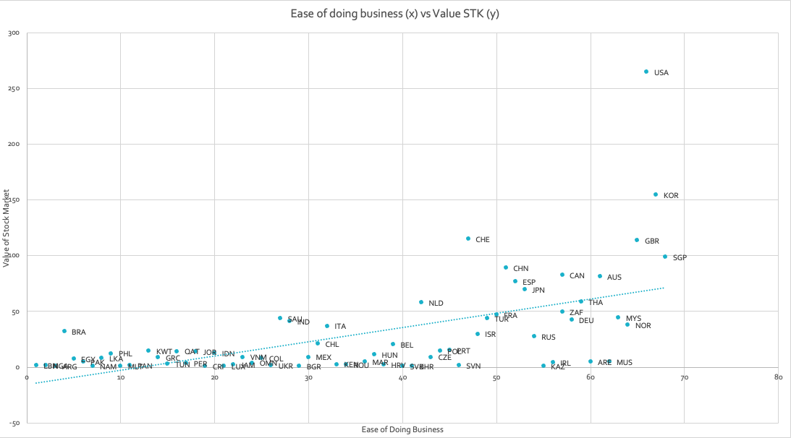
Significant at 1% level
Easier business → Stock market growth
Categorical ease of doing business ?

Slide 7
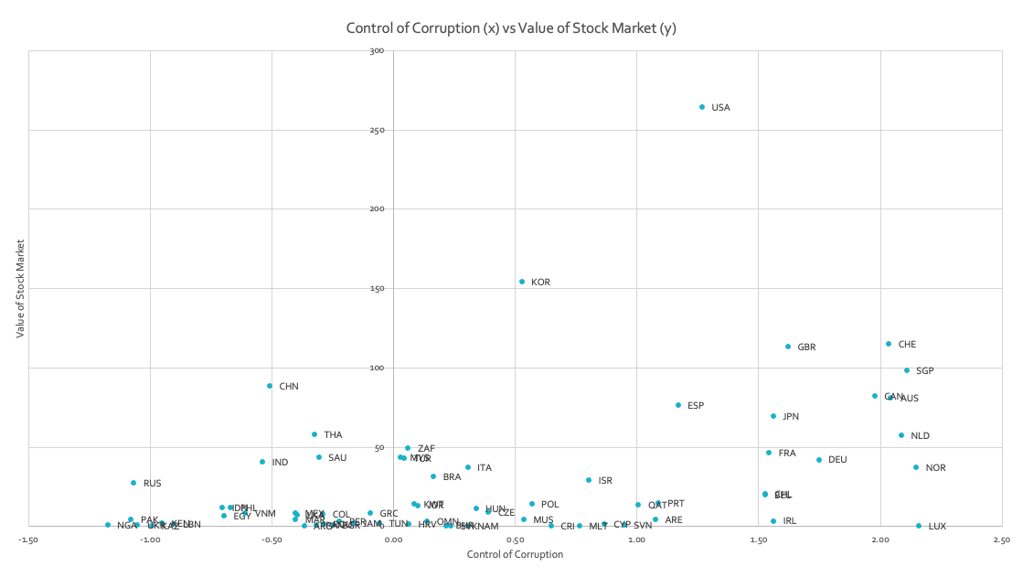
Not Significant
Categorical: Developed Countries

Slide 8
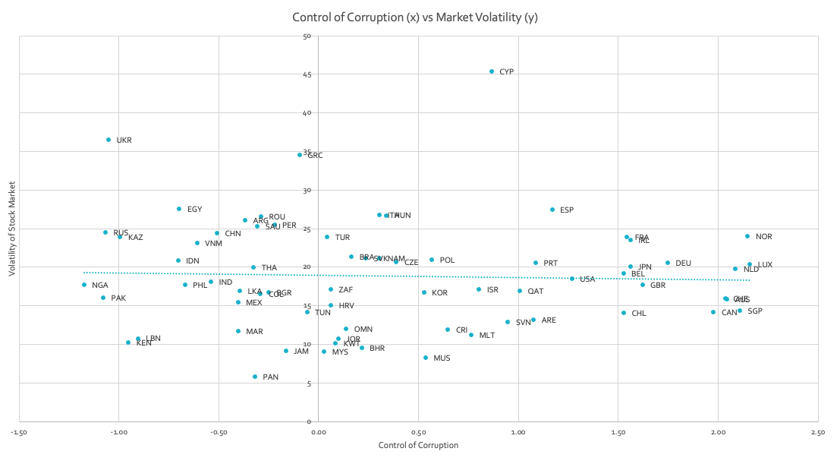
Significant at 10% level
More Control of Corruption → Less Stock Market Volatility
Categorical: Developed countries

Slide 9
Development Effect
“[…] in more developed countries corruption is inversely related to the stock market returns. In developing economies, […] higher levels of corruption impact positively on the stock markets returns” (Tavares 2010)

Slide 10
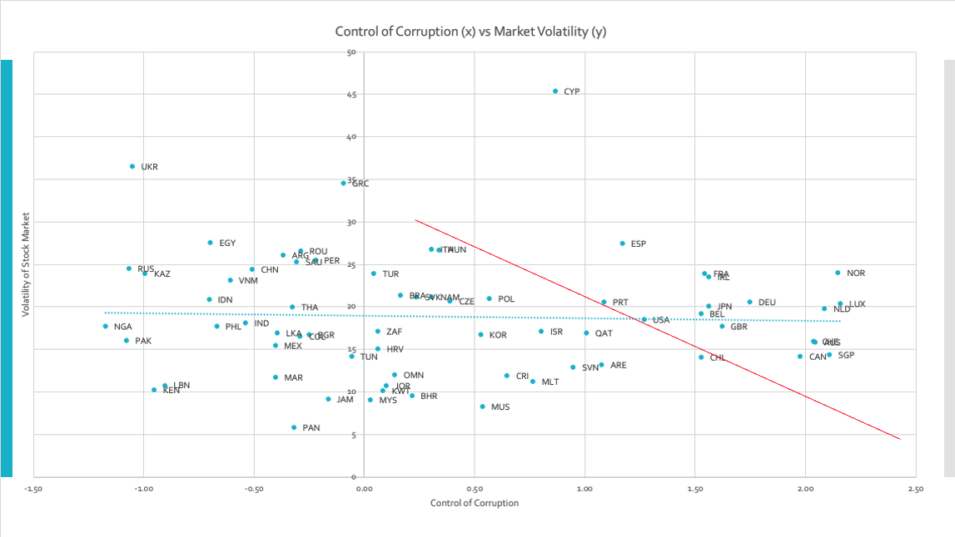
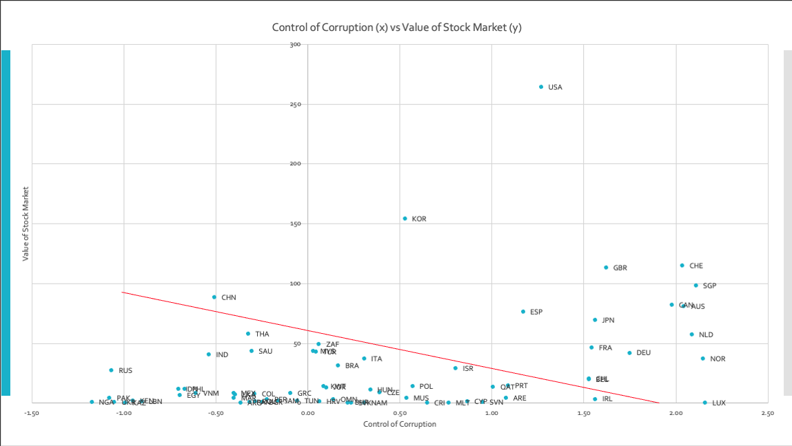
Corruption hurts market/economy
Support for Corruption Equilibria
Grease the wheels

Slide 11
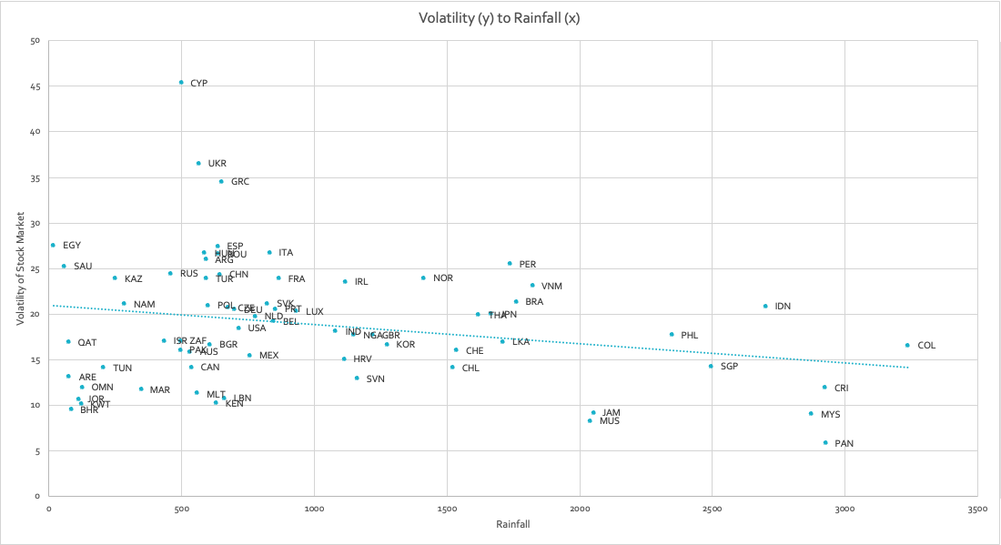
Significant at 5% level
More rain → Less stock market volatility

Slide 12
Next Steps
Development factor
Corruption equilibria and the development barrier
More rain = less volatility ?

